Slide 1
KIS2023 Poster session Autoencoder-Based feature extraction for scene search in Live nature camera
Yukito SEO
Department of information Engineering at KAIT
Mail: s2021065@cco.Kanagawa-it.ac.jp
Notes:
Hello everyone, My name is Yukito SEO.
皆さんこんにちは、瀬尾幸斗と申します。
I belong to the Department of Information Engineering at Kanagawa Institute of Technology.
私は、神奈川工科大学情報工学科に所属しています。 Thank you for your time today.
本日はよろしくお願いします。
I will start my presentation. 私のプレゼンテーションを始めます。
My research theme is “Autoencoder-based Feature Extraction for Scene Search in Live Nature Camera”

Slide 2
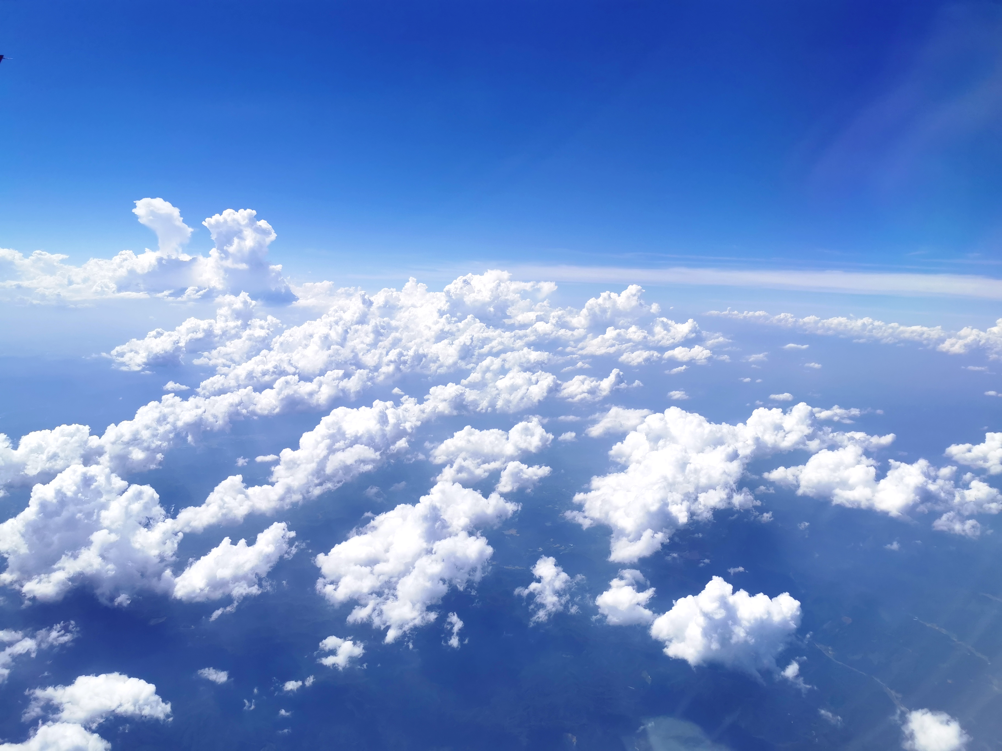

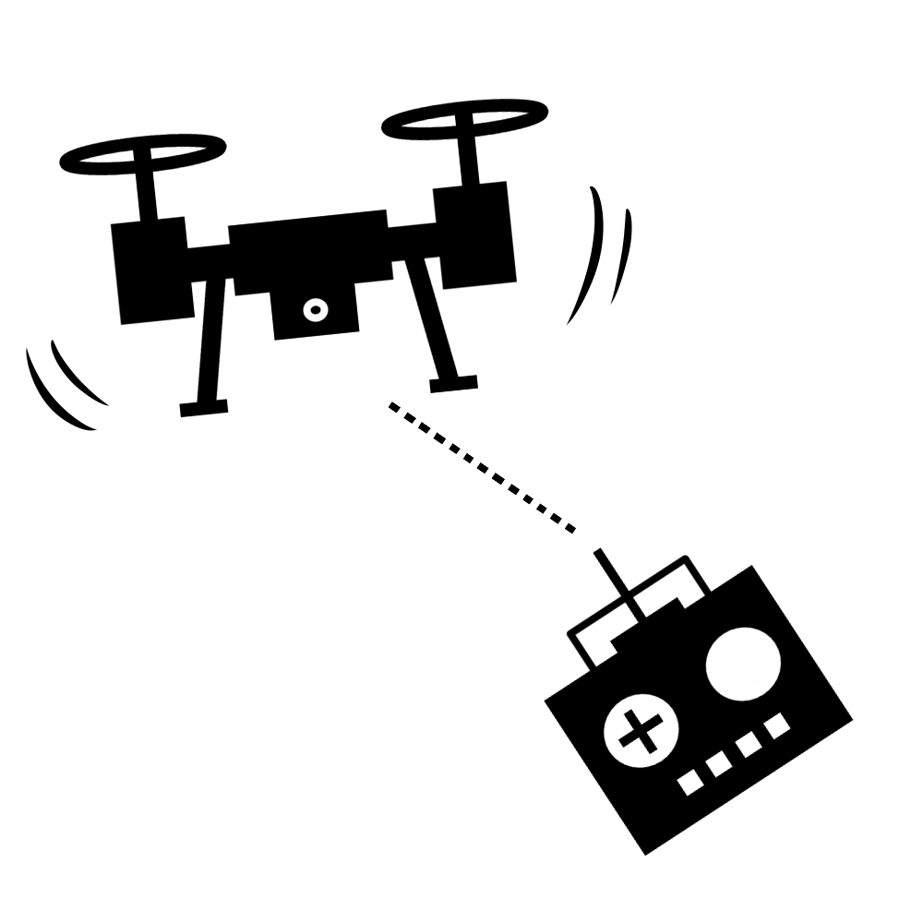



Problem
Global importance of earth observation is increasing
Nature disasters are occurring due to global climate change
A lot of data
No tags
various observations
Difficult to search
we are researching a system that can efficiently search scenes by image features using Live cameras and Autoencoder.
Notes:
Now,The importance of earth observation is world widely increasing due to the effect of global climate change and so on.
現在、地球規模の気候変動の影響により、地球観測の重要性が世界的に高まっています。
Observation is carried out by various methods such as IoT, satellite images, and photography by drones.
IoT、衛星画像、ドローンによる撮影など様々な方法で、観測が行われています。
However, even if we can obtain global observation data, it takes time and effort to find the necessary data.
しかし、地球規模の観測データをとれたとしても、必要なデータを探すには、時間と労力がかかります。
That's because there's a lot of data, and it doesn't always have tags to search for.
それは、データがたくさんあり、また検索するタグが必ずしもついているわけではないからです。
Therefore, we are researching a system that can search scenes by image features using live cameras and autoencoders.
そこで、私たちはライブカメラとオートエンコーダーを使った、画像特徴によるシーン検索ができるシステムの研究をしています。

Slide 3
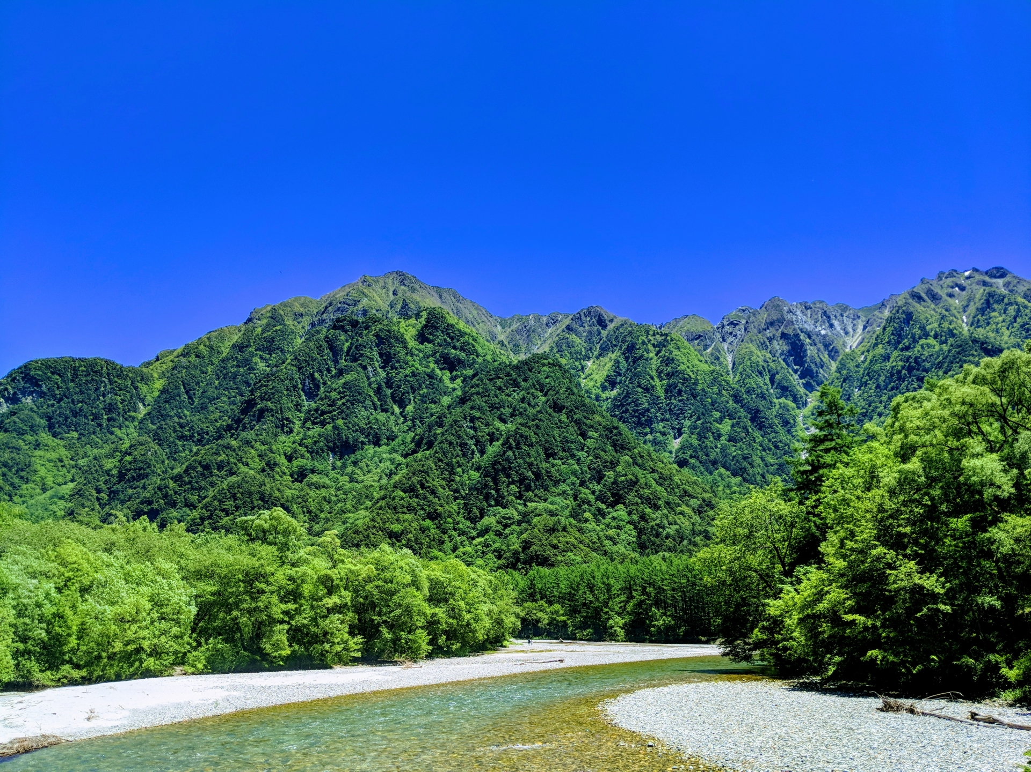
Propose methods
Scene retrieval using image features and indexing methods
Input image
The encoding part
of the autoencoder
feature vector
Encoder
decoder
Nature
Animal
Plant
etc…
Used when the autoencoder trains
Notes:
Here is the proposed method.
first,An autoencoder model is trained with a set of nature images such as landscape, animals, and plants.
Next,Image data from live nature camera is sent to the trained autoencoder model , and the feature vector is extracted.
Here we make use of the encoding part of the autoencoder.

Slide 4
Propose methods
Scene retrieval using image features and indexing methods
Indexing representative
feature vectors
feature vectors
Clustering and search
representative feature vector
Cluster_1 | Cluster_2 | Cluster_3
Data1_1 | Data2_1 | Data3_1
Data1_2 | Data2_2 | Data3_2
Data1_3 | Data2_3 | Data3_3
…
Notes:
Then,The feature vectors extracted are classified based on the vector similarities.
After that ,A representative feature vector such as centroid vector is extracted in each cluster.
In this example, the vector closest to the centroid is taken as the representative feature vector.
finally,Each representative feature vector is indexed for the image search.
Grouping similar images into clusters can reduce the computational complexity of scene search.
類似する画像をクラスターとしてまとめることで、シーン検索の計算量を減らすことができます。
This is our propose mothods.

Slide 5
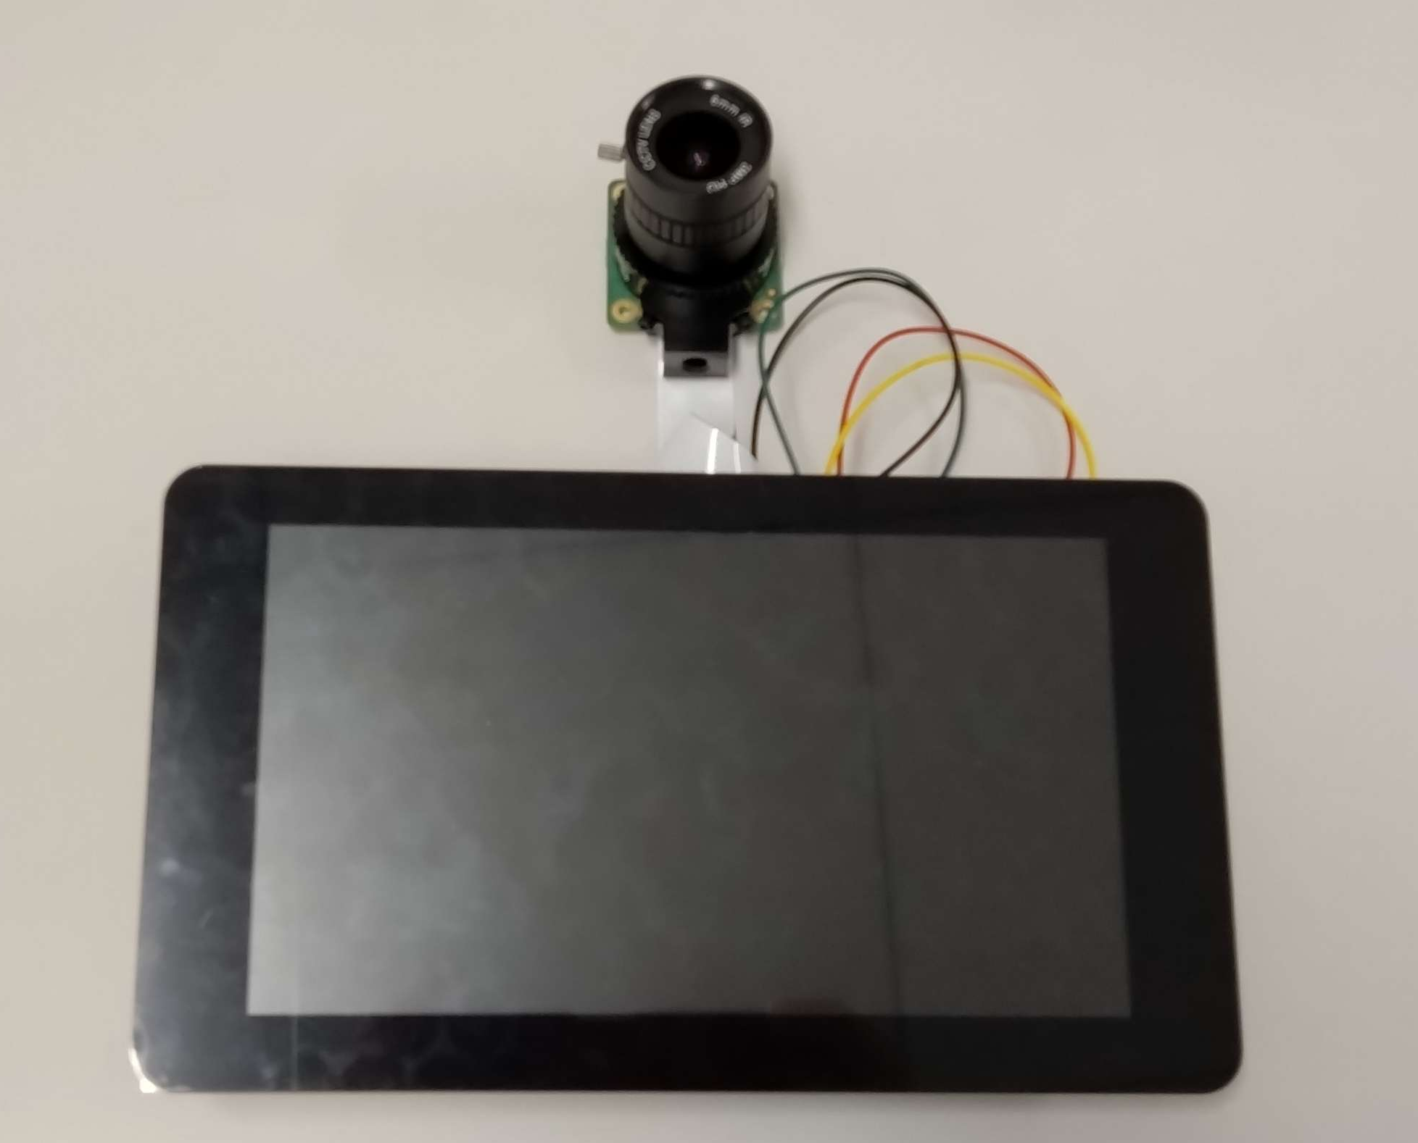
Feature work
Raspberry Pi and
camera device
Evaluate the feasibility
and effectiveness
of the proposed system
How accurate is this system?
What hardware performance do you need?
What is the cost of implementation?
Etc…
Currently creating a system and programs
Need to investigation
Notes:
Currently, we are implementing the prototype of monitoring natural environment.
現在、自然環境モニタリングのプロトタイプを実装中です。
We will evaluate the feasibility and effectiveness of the proposed system in our future work.
今後の研究において、提案したシステムの実現可能性と有効性を評価していきます。
That’s all.
Thank you for your attention.

Slide 6
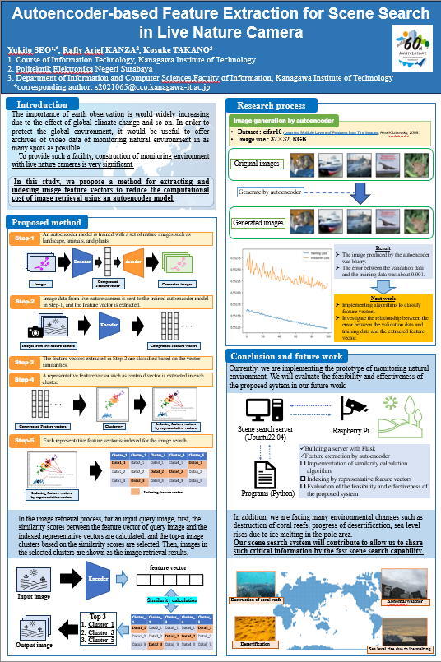
Feature work
Thank you for your time!
This is our poster ➡
Title:
Autoencoder-based Feature Extraction for Scene Search in Live Nature Camera
Presenter: Yukito SEO
Collaborator: Arief Rafly KANZA,
Prof.Kosuke TAKANO
Mail: s2021065@cco.Kanagawa-it.ac.jp
Notes:
Currently, we are implementing the prototype of monitoring natural environment.
現在、自然環境モニタリングのプロトタイプを実装中です。
We will evaluate the feasibility and effectiveness of the proposed system in our future work.
今後の研究において、提案したシステムの実現可能性と有効性を評価していきます。
That’s all.
Thank you for your attention.

